Slide 1
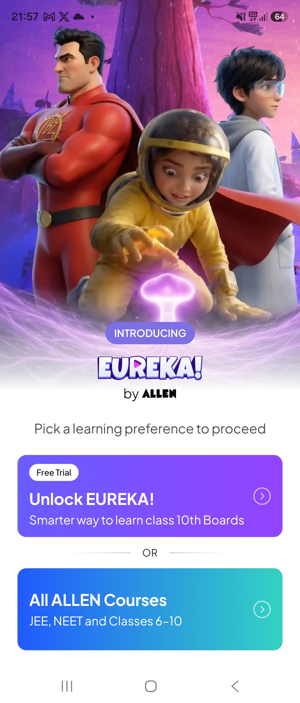
PRODUCT TEARDOWN
EUREKA by ALLEN
Nikita Singh — PM Intern Assessment
Class 10 Board Prep App | 10-Slide Deep Dive

Slide 2
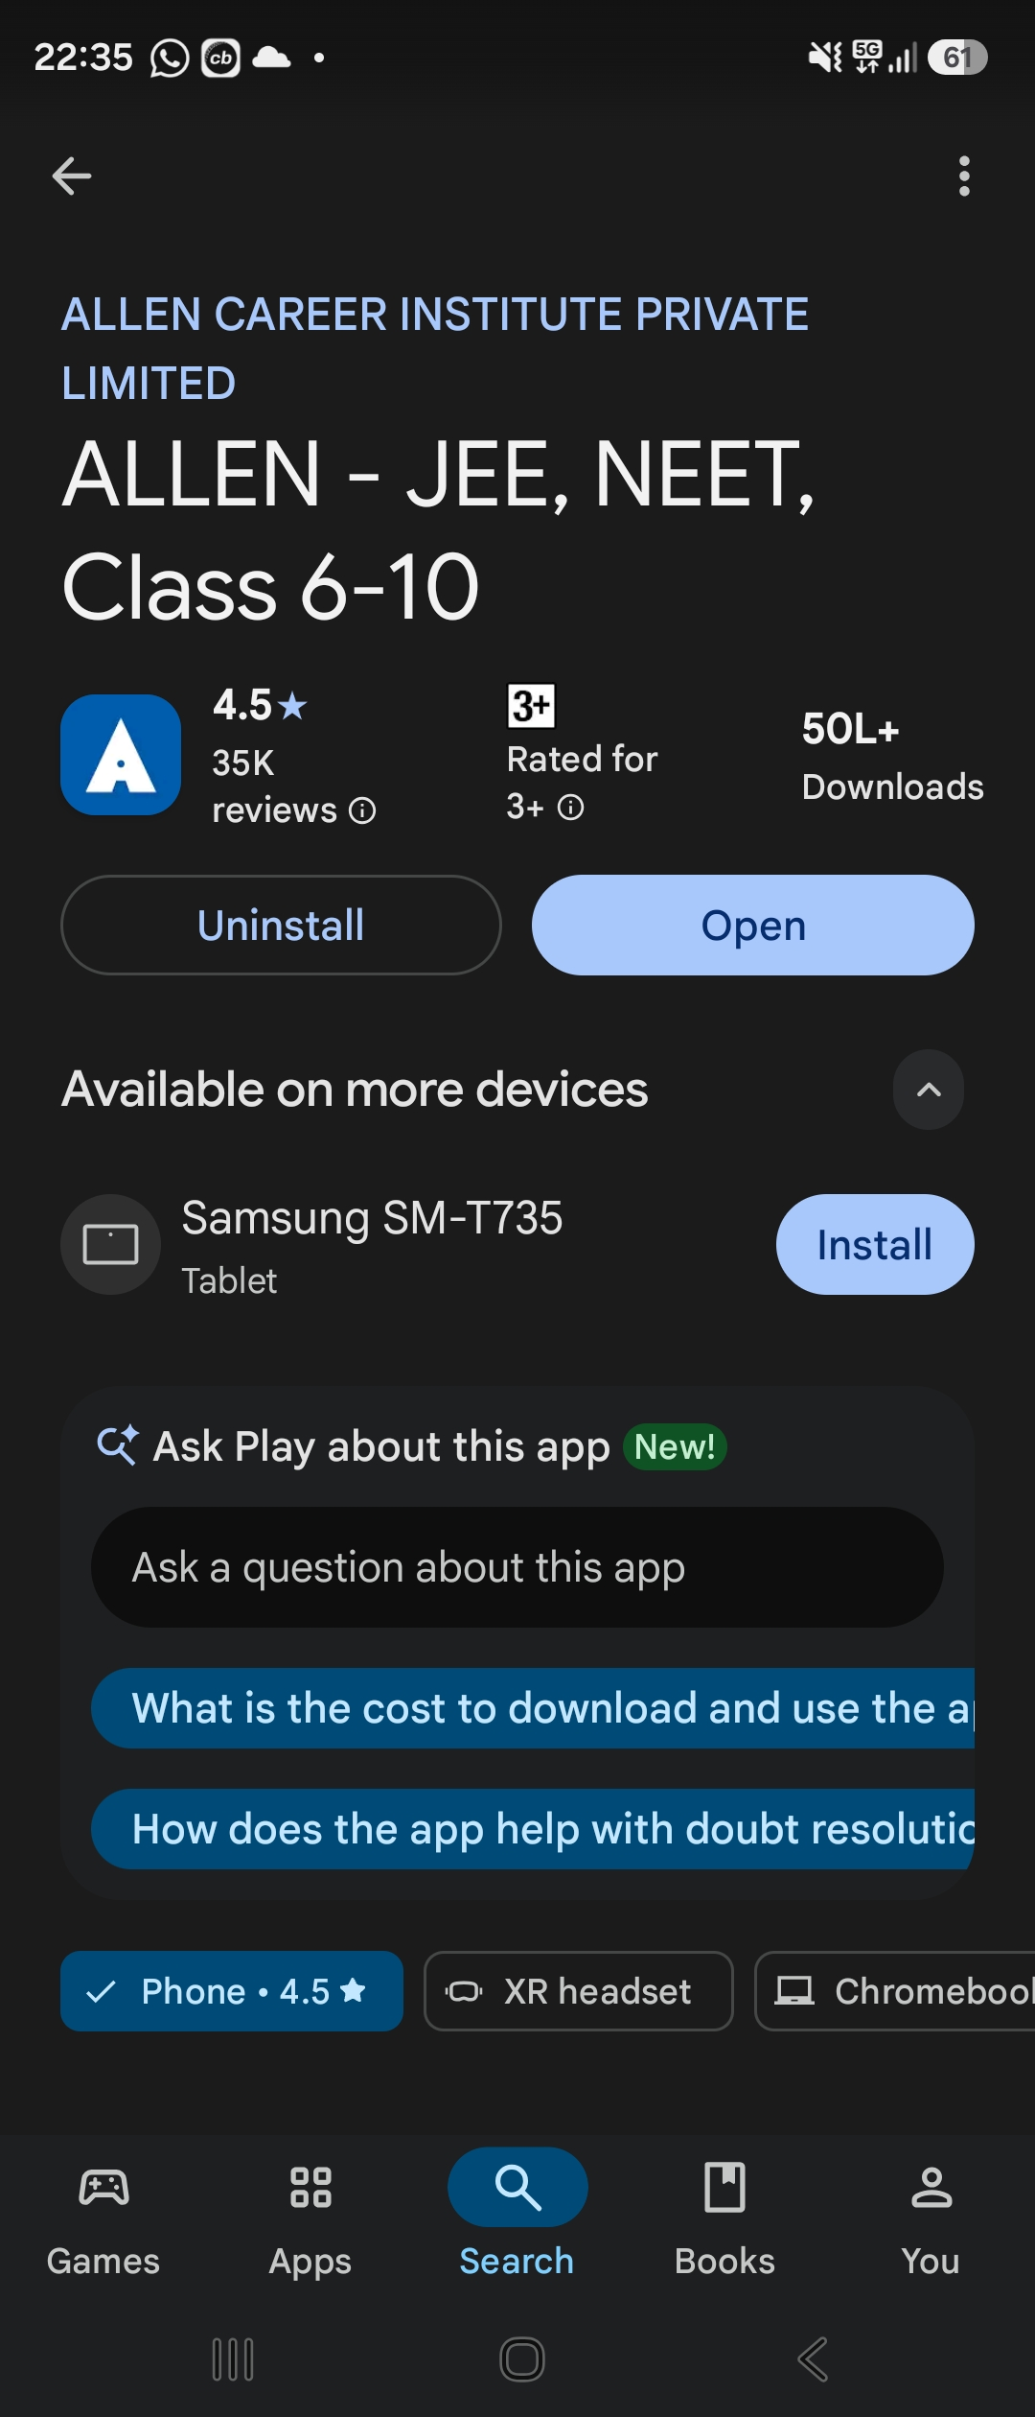
What is Eureka?
POSITIONING
"No more ratta. Concepts samjho." — Story-led video lessons + practice for Class 10 boards.
TARGET USER
Class 10 students (CBSE / State boards). Parents seeking trusted, structured prep with measurable outcomes.
CORE VALUE PROP
Cinematic lessons → practice → progress → doubt support. All under ALLEN's brand umbrella.
PEDAGOGY
Themed episodes replace rote-learning videos. Concept-first → exam-second.
TRUST DNA
Powered by ALLEN — JEE/NEET prep institute since 1988. Play Store: 4.5★ · 50L+ downloads.
01 / 10

Slide 3
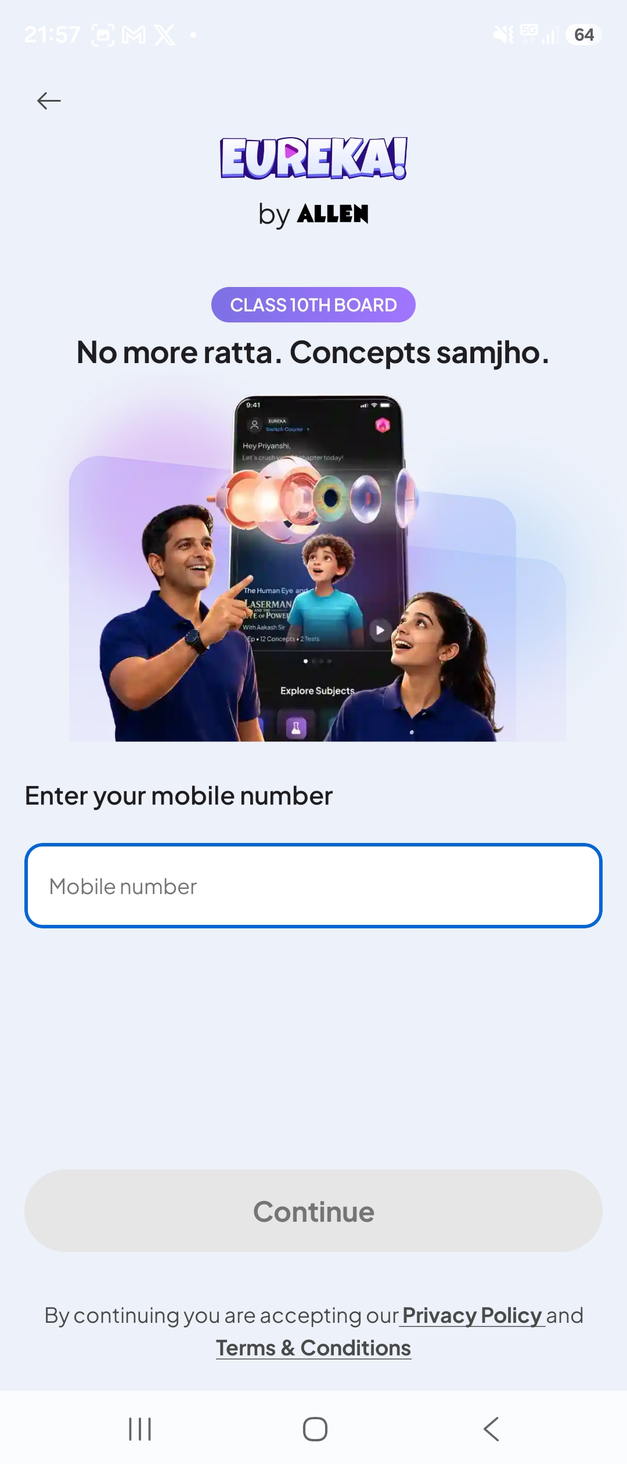
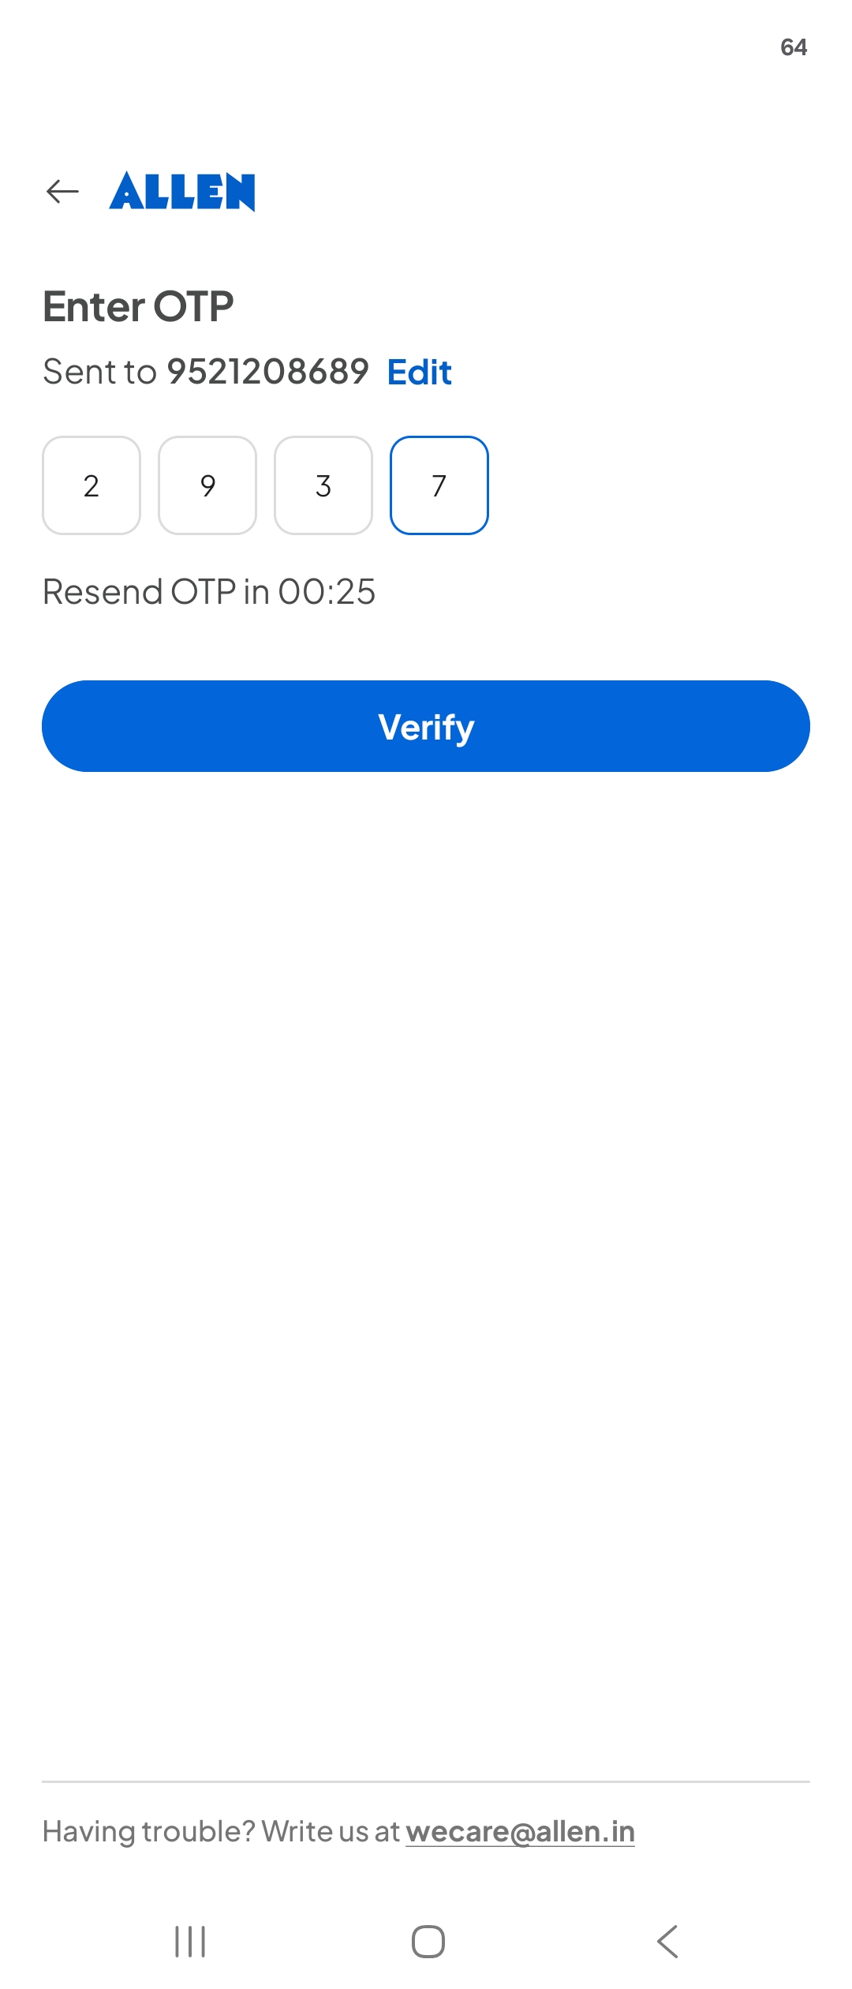
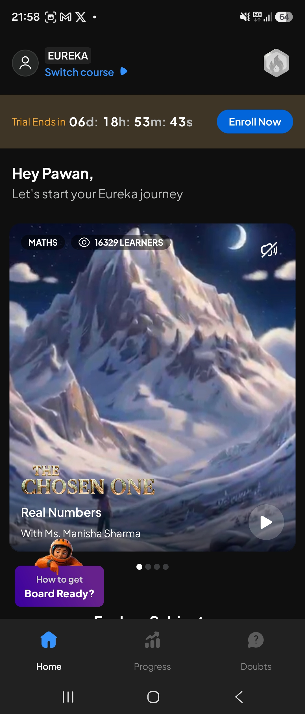
Onboarding Teardown
4 CLICKS TO FIRST CONTENT
UNLOCK EUREKA!
PHONE LOGIN
OTP
HOME
PLAY
~1-2 MINUTES TO FIRST CONTENT
FRICTIONS OBSERVED
Early Fork — "All ALLEN Courses" diverts new users from Eureka.
Login Wall — Phone + OTP before any product preview.
Banner Gap — Countdown shown — but zero inclusions.
02 / 10

Slide 4
Core Experience: The Student Learning Loop
WATCH
PRACTICE
TRACK
DOUBTS
KEY FEATURES
Video Lessons — Themed episode "The Chosen One — Real Numbers" by Ms. Manisha Sharma. Social proof: 16,329 learners visible on the tile.
Practice & Doubts — Bite-size questions with instant feedback. Bottom nav: Home · Progress · Doubts — the three pillars of the learning loop.
Purchase Flow — Trial timer creates urgency but ZERO inclusions shown. "Enroll Now" pinned next to timer — discoverable but doesn't dominate the lesson tile.
03 / 10

Slide 5
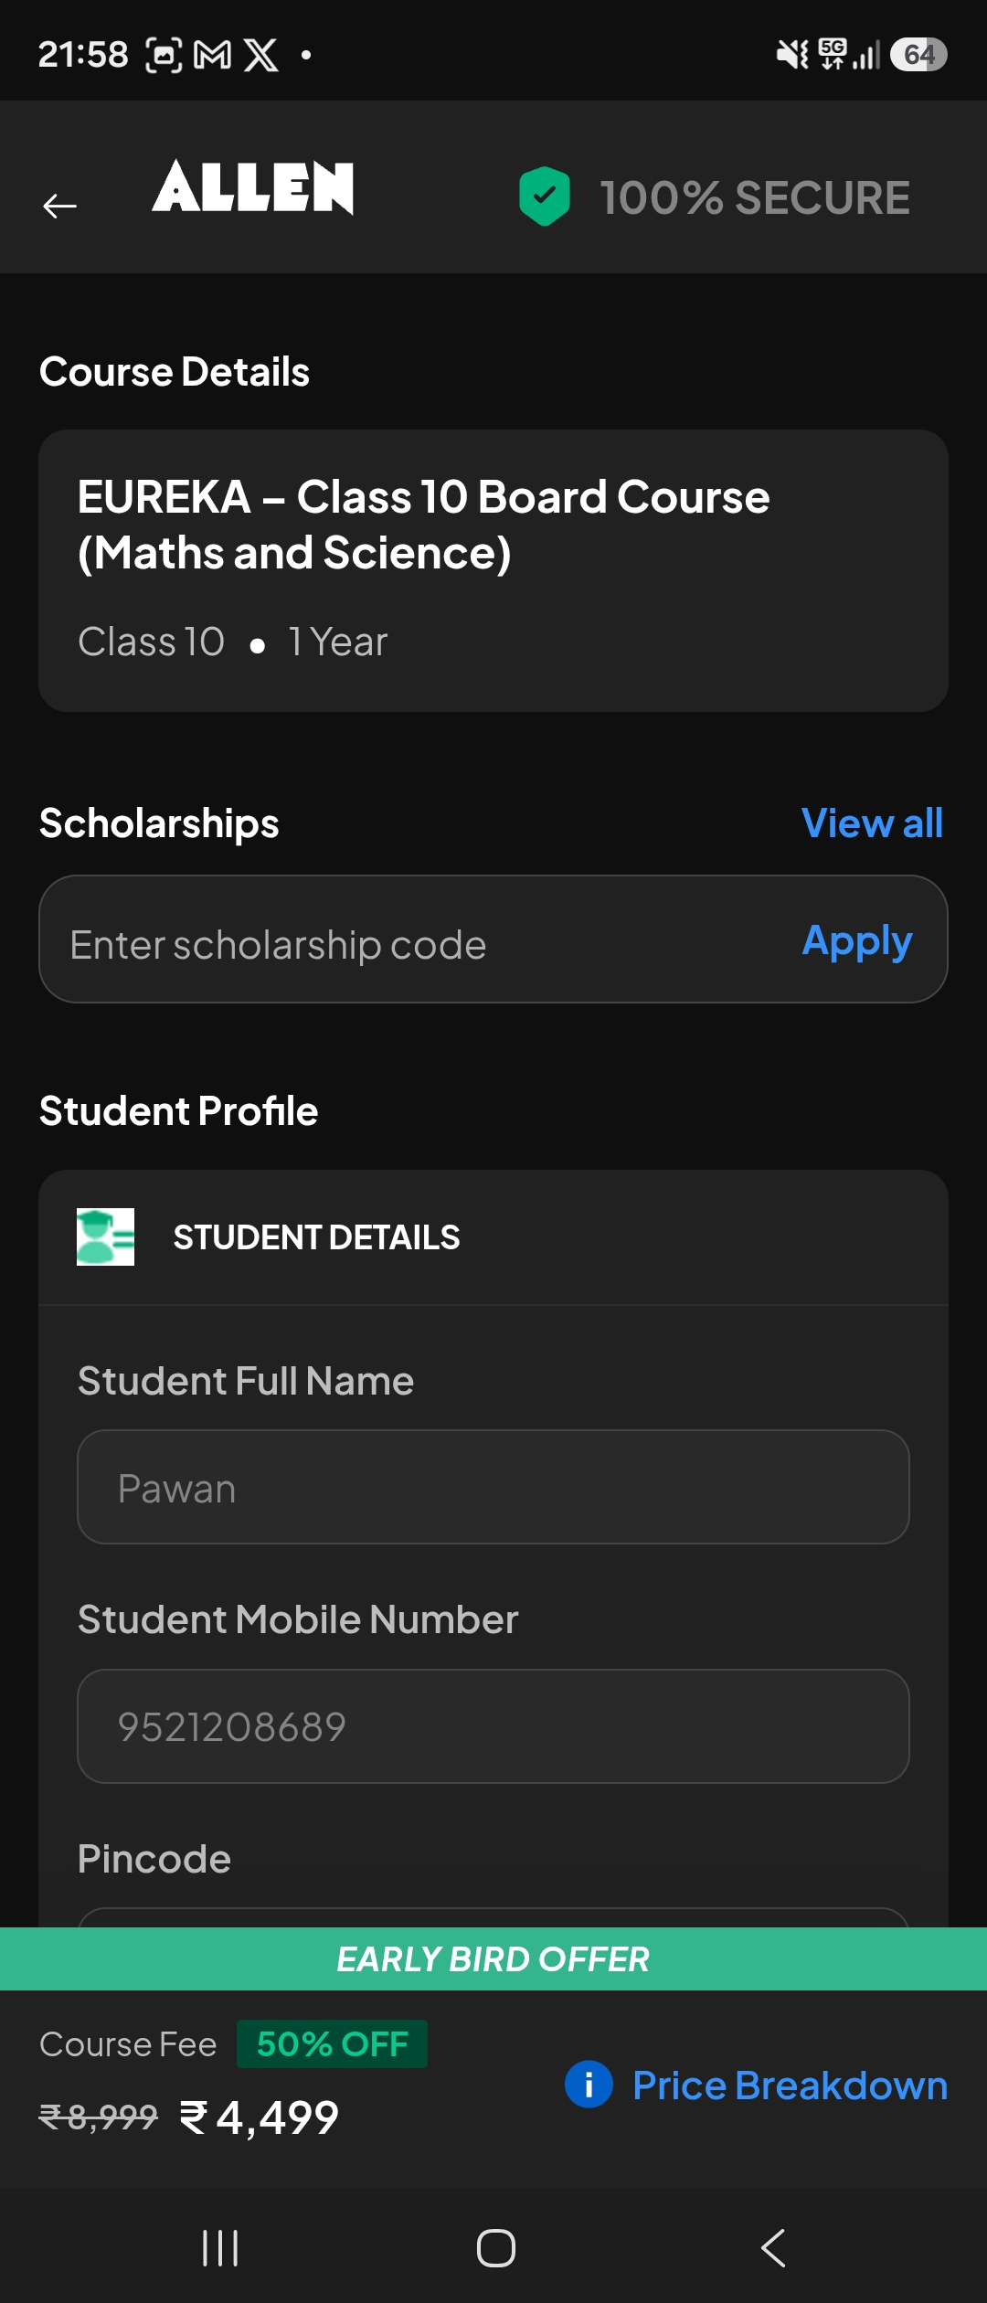
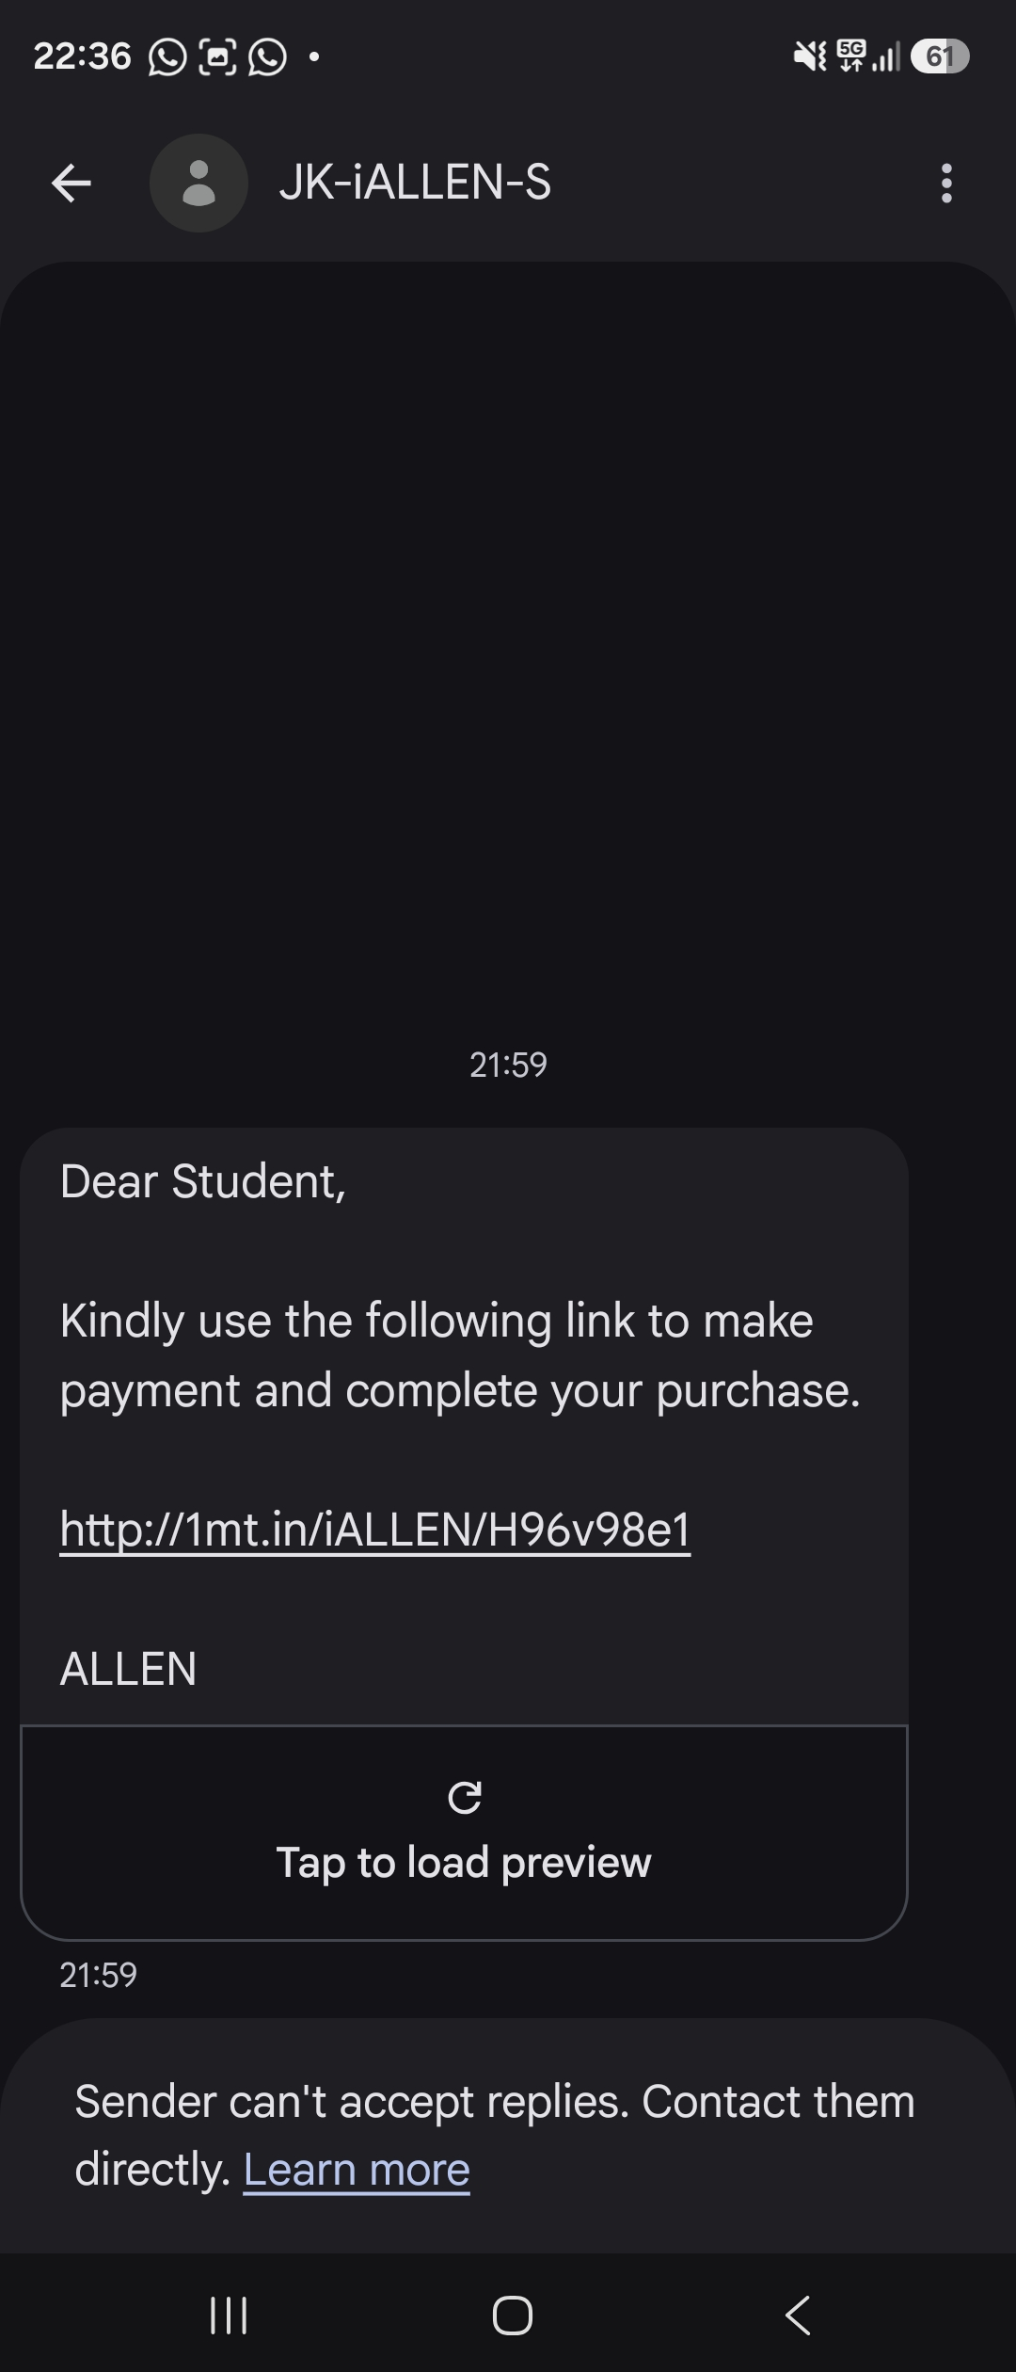
What's Working + Positive Reviews
Clear Positioning
Smart Pricing Frame
Social Proof
3D characters + "INTRODUCING EUREKA!" splash. Curiosity in <3 sec. Cinematic story-led hook differentiates from generic ed-tech.
ALLEN logo + 100% SECURE badge + Early Bird Offer at checkout. Trust signals stacked at every conversion point.
"Faculty quality · Concept clarity · Study material · Doubt solving · Exam prep." Validated by 5★ users. Content is the moat.
GOOGLE PLAY STORE — POSITIVE REVIEWS
★★★★★
"Best learning platform"
Faculty quality, concept clarity, study materials, doubt solving, exam prep support. Almost no criticism of educational quality.
★★★★☆
"Like it, want it better"
Want larger custom practice sets, multi-subject sessions, better search. Satisfied but requesting enhancements.
04 / 10

Slide 6
What's Not Working + Negative Reviews
Confusing First Choices
GOOGLE PLAY STORE — NEGATIVE REVIEWS
Landing: "Unlock EUREKA!" + "All ALLEN Courses" side-by-side — fragments user intent.
★★☆☆☆
"Good content, can't trust it"
App crashes during tests, lost assessment progress, unreliable long study sessions.
Value Unclear in Trial
Banner: "Trial Ends in 06d : 18h". No inclusions, no lose-state — urgency without information.
★☆☆☆☆
"Want to study, app won't let me"
Login failures, "Something went wrong", classes not loading, videos inaccessible.
Friction-Heavy Checkout
Long Student Profile + scholarship hunt BEFORE the payment CTA. Multi-fold friction at checkout.
★★★☆☆
"Potential, inconsistent"
"Play vs Enroll Now" Confusion
Upload stuck at 0%, false "No Internet" errors, assessment submission failures.
Users ignore the banner and jump into checkout prematurely
05 / 10

Slide 7
One Big Opportunity: Productize the Free Trial
THE PROBLEM
Timer creates urgency but no clarity — students don't know what they get, pay for, or lose.
EXPECTED IMPACT
+30%
THE SOLUTION
Trial Completion Rate
Make Trial a Clear, Self-Contained Offer
"6-Day Trial" — 2 Chapters, 40 min video, 20 questions, 1 doubt
+25%
Progress chip: "Trial 0/2 completed" visible on Home
Smart CTA: "Continue Trial" → "Enroll Now to Unlock"
Conversion to Paid
Value line: "Full Course: 40+ lessons, 80+ practice, Unlimited doubts"
-40%
HOW TO EXECUTE
Checkout Drop-off
Checkout Summary
Value Mirror
NOTIFICATION EXAMPLE
"You are on Day X of 6" — show chapters done, access left, questions remaining
Show "Full Access Includes" below price: 40+ lessons, 80+ practice, Unlimited doubts
Day 3: "1 chapter left in your free trial. Complete it to unlock an exclusive discount."
Day 5: "Your trial ends tomorrow. Enroll now — 50% Early Bird still active."
06 / 10

Slide 8
User Job → Pain → Gain
USER JOB
USER PAIN
USER GAIN
Learn Class 10 Maths & Science efficiently and score well in boards
What is bothering them?
What they want
Early decision overload
Free trial vs full course confusion
"Play vs Enroll Now" confusion
Trial timer without instructions
Unclear what they get for free
Clear Trial Content — How many chapters? Practice? Doubt support?
Transparent Upgrade Path — Connect trial value to full course
Clear progression — Know exactly what's included
DESIRED LEARNING LOOP
WATCH
PRACTICE
TRACK
DOUBTS
(Repeat loop)
07 / 10

Slide 9
Product & Service → Pain Relievers → Gain Creators
WHAT OUR PRODUCT IS
PAIN RELIEVERS
GAIN CREATORS
Board-prep program for Maths & Science built around conceptual understanding
Provide What Users Want
Clear Progression-Linked Incentives
Reduce decision effort before learning
One-tap start lesson
Clear trial instructions
Visible "Trial 0/2 Completed" chip
Simplify checkout — Minimal fields
Transparent price breakdown
Refund/help links
Recognized payment badges
Complete trial → unlock discount
Show exactly what is included
Connect trial value to full-course value
Clear upgrade path with transparent pricing
FEATURES
Cinematic/story-led video lessons
Guided practice with instant feedback
Progress dashboard
Doubt resolution
Social proof on each module
ACCESS MODEL
Free trial → 1-year subscription
Structured syllabus (CBSE / State Board)
08 / 10

Slide 10
09 / 10
SLIDE 09 · EUREKA TEARDOWN
Prioritization Matrix — Value × Effort.
Where to start: quick wins ship this sprint, big bets follow in the roadmap.
QUICK WINS
BIG BETS
↑ HIGH VALUE
DO FIRST · this sprint
DO NOW
PLAN · next roadmap
Clarify Trial Offer
Personalised Checkout Summary
Progress Chip
Trial → Discount Journey
Continue Trial CTA
Automated Progress Nudges
FILL-INS
AVOID · LOW PRIORITY
BACKLOG · when bandwidth
DEPRIORITISE
Payment Badges
Advanced Gamification
↓ LOW VALUE
Refund Links
Complex Personalization
Price Breakdown
← LOW EFFORT
HIGH EFFORT →
Quick Wins = the entire Productise-the-Trial recommendation. Ship in this sprint, compound with Big Bets next.

Slide 11
10 / 11
SLIDE 10 · EUREKA TEARDOWN
Before → After + my POV.
The same Home screen — reframed as a self-contained trial product.
BEFORE
AFTER
→ Banner: timer only. No "what's included".
→ Generic "Enroll Now" CTA throughout.
→ No progress signal across the 6 days.
→ Checkout doesn't mirror trial value.
6-DAY TRIAL · DAY 3 OF 6
Trial 1/2 chapters completed
▶ Continue Trial
10 Qs left · 1 doubt
→ Explicit inclusions + visible progress.
→ State-aware CTA: Continue Trial → Unlock Lesson 2.
→ Day-3 nudge unlocks an exclusive discount.
USER MENTAL MODEL
USER MENTAL MODEL
"Why should I pay ₹4,499? What do I lose if I don't?"
"I've done half — let me finish & unlock the rest."
↑ Trial → Paid
↓ Checkout drop-off
↑ Activation rate
↑ Parent-shared WOM
MY POV
Eureka has world-class content & trust — but the trial behaves like a countdown, not a product. Productise it.

Slide 12
THANK YOU
11 / 11

